Slide 1
Mathematical Economics
Lecture 7

Slide 2

Plan
Compact sets
Examples of compact sets
Properties of compact sets
Compact sets in $ℝ^{m}$
Continuous functions on compact sets

Slide 3
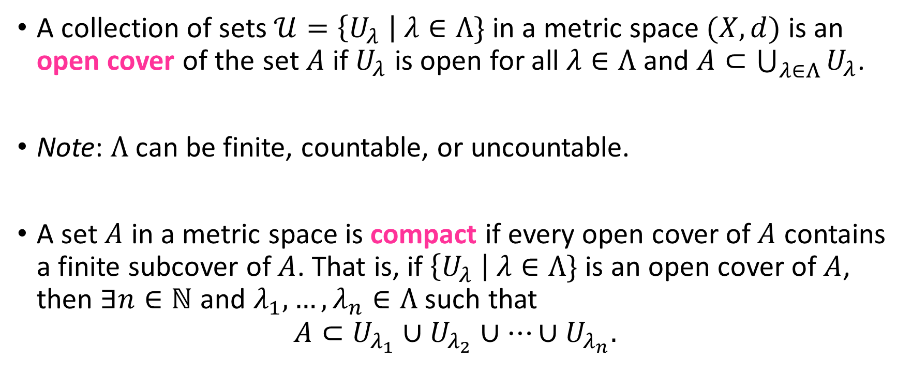
Compact Sets
A collection of sets $𝒰=\left\{U_{λ} \right| λ∈Λ\}$ in a metric space $(X,d)$ is an open cover of the set $A$ if $U_{λ}$ is open for all $λ∈Λ$ and $A⊂\bigcup_{λ∈Λ}{U_{λ}}$.
Note: $Λ$ can be finite, countable, or uncountable.
A set $A$ in a metric space is compact if every open cover of $A$ contains a finite subcover of $A$. That is, if $\left\{U_{λ} \right| λ∈Λ\}$ is an open cover of $A$, then $∃n∈ℕ$ and $λ_{1},…,λ_{n}∈Λ$ such that
$$A⊂U_{λ_{1}}∪U_{λ_{2}}∪…∪U_{λ_{n}}.$$

Slide 4
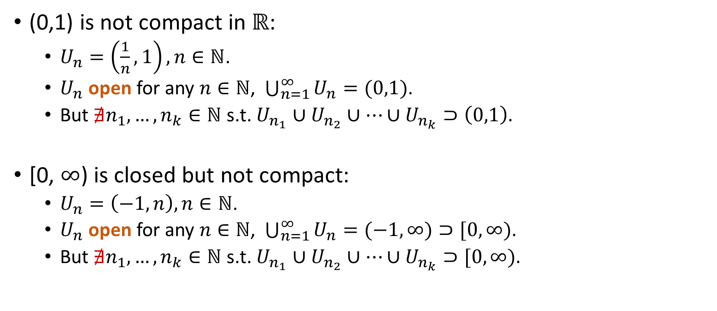
Examples
(0,1) is not compact in $ℝ$:
$U_{n}=\left(\frac{1}{n},1\right), n∈ℕ$.
$U_{n}$ open for any $n∈ℕ$, $\bigcup_{n=1}^{∞}{U_{n}=(0,1)}$.
But $∄n_{1},…,n_{k}∈ℕ$ s.t. $U_{n_{1}}∪U_{n_{2}}∪…∪U_{n_{k}}⊃\left(0,1\right).$
[0, $∞$) is closed but not compact:
$U_{n}=\left(−1,n\right), n∈ℕ$.
$U_{n}$ open for any $n∈ℕ$, $\bigcup_{n=1}^{∞}{U_{n}=(−1,∞)}⊃[0,∞)$.
But $∄n_{1},…,n_{k}∈ℕ$ s.t. $U_{n_{1}}∪U_{n_{2}}∪…∪U_{n_{k}}⊃[0,∞).$

Slide 5
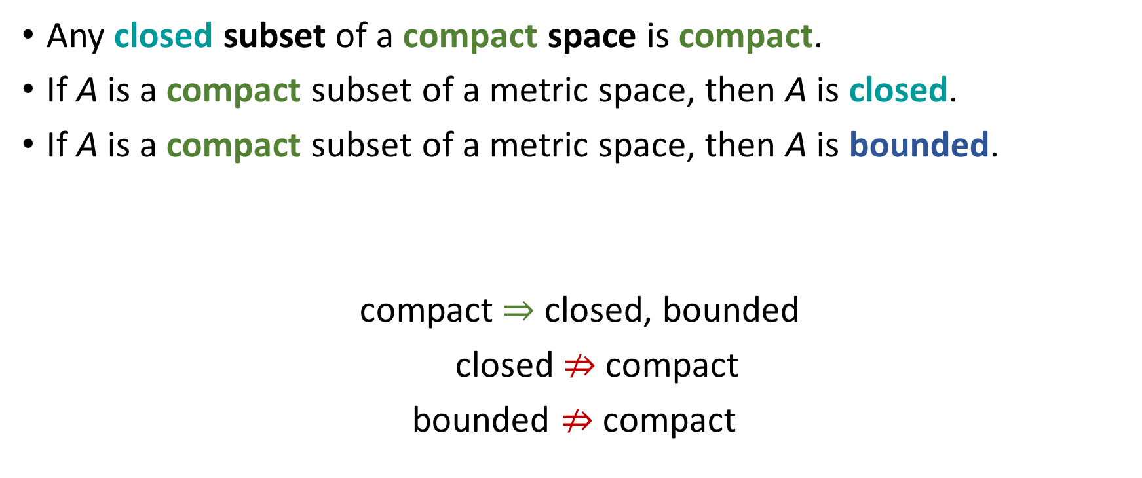
Properties of Compact Sets
Any closed subset of a compact space is compact.
If A is a compact subset of a metric space, then A is closed.
If A is a compact subset of a metric space, then A is bounded.
compact $⇒$ closed, bounded
closed $⇏$ compact
bounded $⇏$ compact

Slide 6
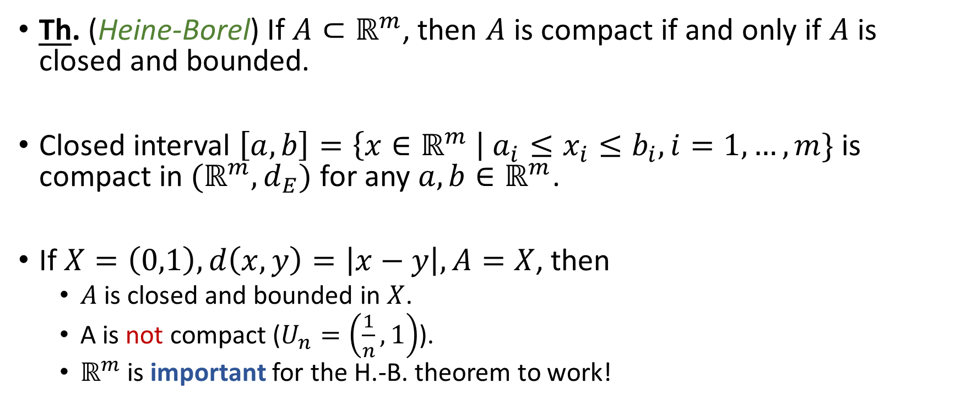

Compact Sets in $ℝ^{m}$
Th. (Heine-Borel) If $A⊂ℝ^{m}$, then $A$ is compact if and only if $A$ is closed and bounded.
Closed interval $\left[a,b\right]=\left\{x∈ℝ^{m} \right| a_{i}≤x_{i}≤b_{i}, i=1,…,m\}$ is compact in ${(ℝ}^{m},d_{E})$ for any $a,b∈ℝ^{m}$.
If $X=\left(0,1\right), d\left(x,y\right)=\left|x−y\right|, A=X$, then
$A$ is closed and bounded in $X$.
A is not compact ($U_{n}=\left(\frac{1}{n},1\right)$).
$ℝ^{m}$ is important for the H.-B. theorem to work!

Slide 7
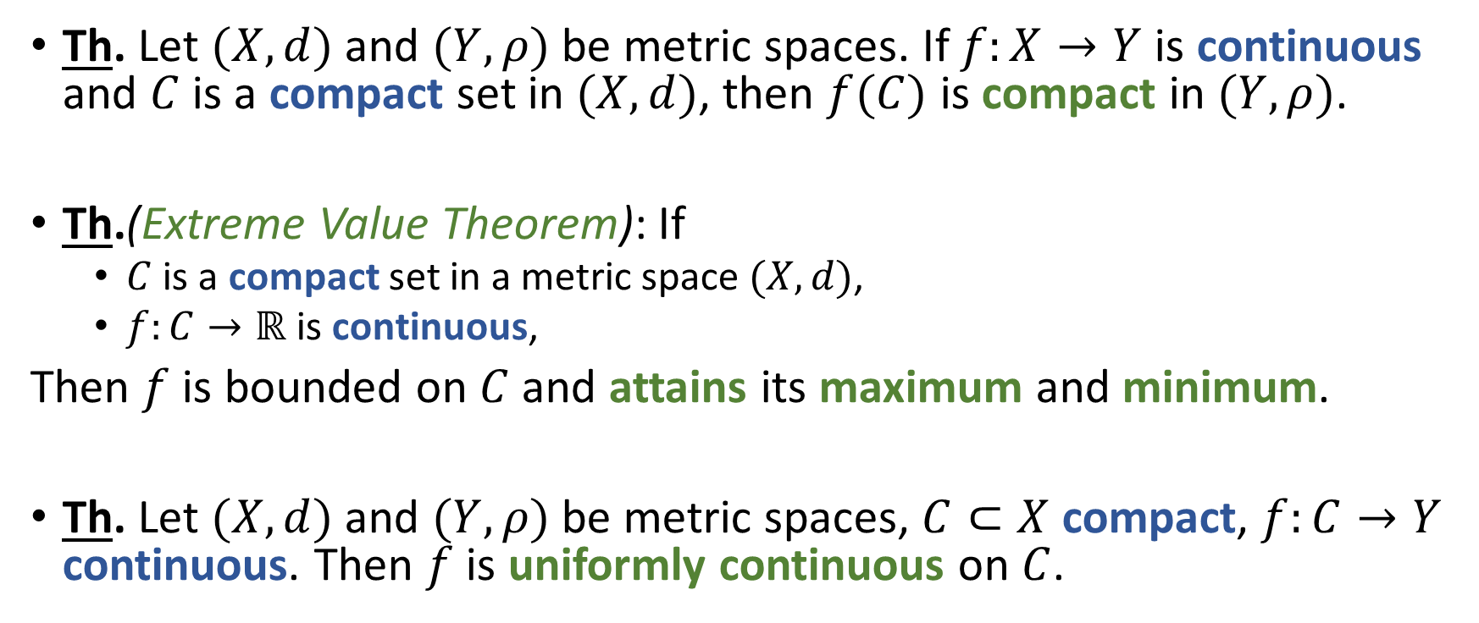
Continuous Functions on Compacts
Th. Let $(X,d)$ and $(Y,ρ)$ be metric spaces. If $f:X→Y$ is continuous and $C$ is a compact set in $(X,d)$, then $f(C)$ is compact in $(Y,ρ)$.
Th.(Extreme Value Theorem): If
$C$ is a compact set in a metric space $(X,d)$,
$f:C→ℝ$ is continuous,
Then $f$ is bounded on $C$ and attains its maximum and minimum.
Th. Let $(X,d)$ and $(Y,ρ)$ be metric spaces, $C⊂X$ compact, $f:C→Y$ continuous. Then $f$ is uniformly continuous on $C$.

